Slide 1
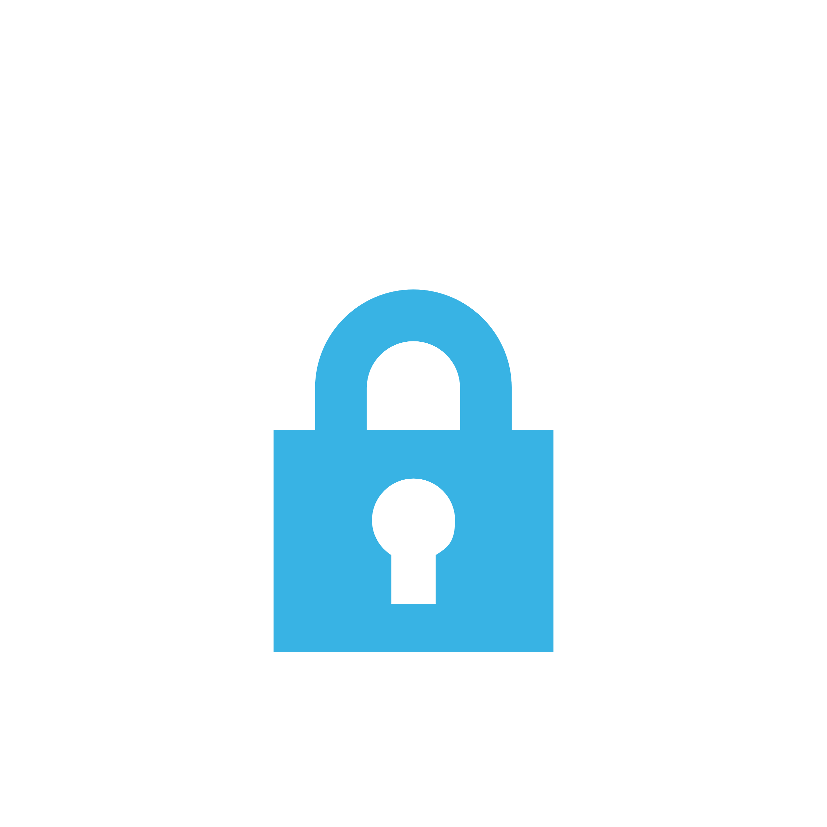
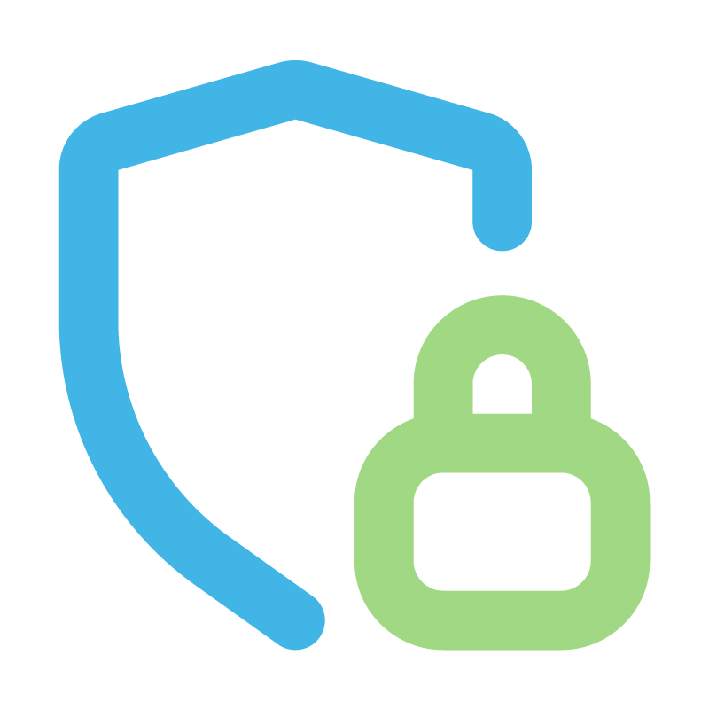
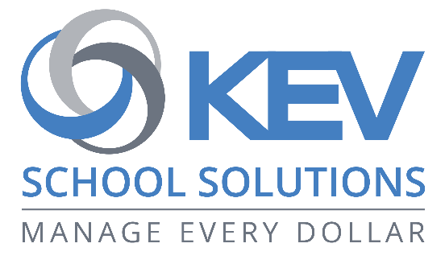
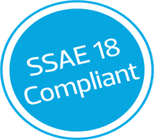
Pay online for school fees,
safely and securely
xyz.schoolcashonline.com
Replace with your SCO domain
Use https://www.kevclientsuccess.com/qrcode and generate a QR code for your SchoolCash Online page. Save the QR code image to your computer. Then replace this image (right-click > Change Picture) with your downloaded image.
Security
Your information and payment details are safe with us. We use strong encryption and regularly test for security risks. You can feel confident that SchoolCash Online is secure and well-guarded.
Compliance
KEV holds the highest industry security certifications, ensuring that your payment information is handled with the utmost care and attention to safety.
Reliability
Our US data centers have top-level security checks, so you can trust that the system is reliable and well-protected against potential threats.
Privacy
Your family's privacy is a top priority. We have clear guidelines on how we handle and protect personal information.
Replace with your SCO domain
SchoolCash Online has been designed with the highest level of security at its core.
xyz.schoolcashonline.com

